Slide 1

Machine Learning Midterm – Group 2
By: Jun, Rida, Neha, and Emmanuel

Slide 2
Purpose
Exploring supervised and unsupervised learning using regression and classification models.
Analyze datasets, visualize relationships, and evaluate model performance.
Tools used : NumPy, Pandas, Scikit-learn, and Matplotlib.

Slide 3
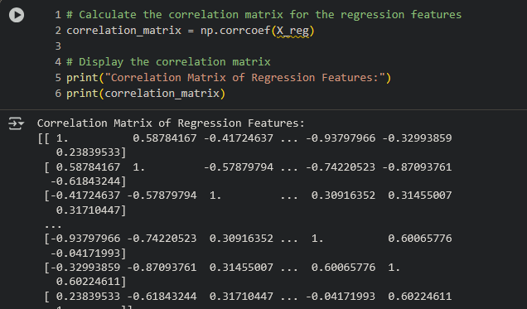
Data Exploration
Purpose: Understand dataset structure and relationships.
Numerical values (close to 1 or -1 for strong correlations, close to 0 for weak correlations)
Notes:
Observation: Reveals strong relationships between certain variables, guiding feature selection.

Slide 4
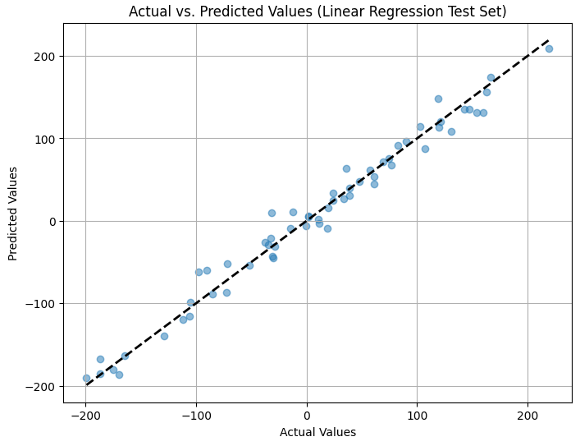
Regression Model (Linear Regression)
Purpose: Predict continuous target variable using regression
RMSE comparison or predictions vs. actuals line plot.
Notes:
Observation: Low RMSE indicates good model fit and generalization.
The plot shows how closely the model's predictions align with the actual values in the test set.
Root mean square error or root mean square deviation is one of the most commonly used measures for evaluating the quality of predictions.

Slide 5
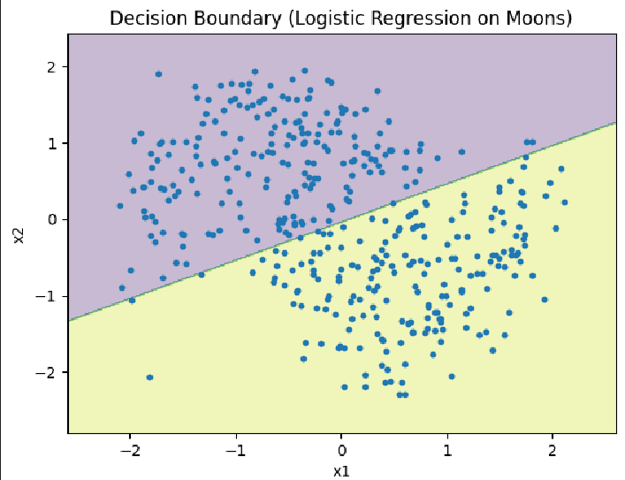
Classification Model – Logistic Regression
Purpose: Classify data points into categories.
Observation: Decision boundary shows how model separates two classes.
Notes:
Dataset: make moons
The Decision Boundary is the line where the model's predicted probability of belonging to one class is equal to the probability of belonging to the other class
Points on one side of the boundary are classified as one class, and points on the other side are classified as the other class. The shape of the decision boundary reflects how the model has learned to separate the two classes based on the features.

Slide 6
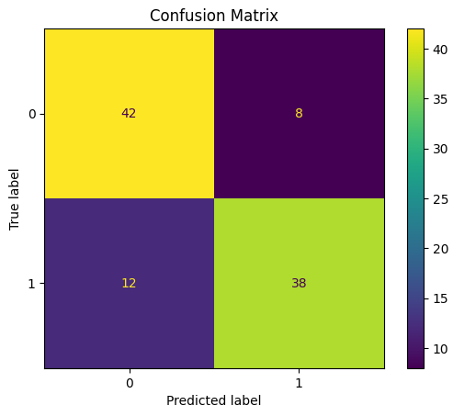
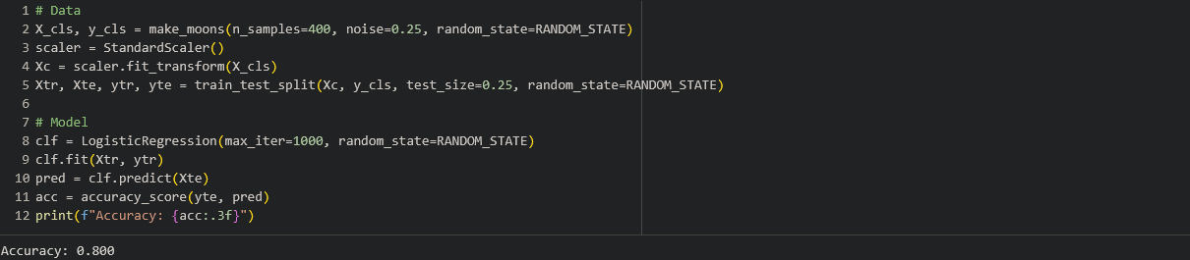
Model Evaluation
Purpose: Assess classification performance using metrics.
Notes:
Observation: Highlights correct vs incorrect classifications and class balance.
This score tells us that the model correctly classified 80% of the instances in the test set.
Confusion Matrix: This gives you a more detailed breakdown of where the 20% errors occurred. By looking at the numbers in the confusion matrix (True Positives, True Negatives, False Positives, False Negatives), you can see specifically how many instances of each class were correctly and incorrectly classified. For example, you can see how many times the model predicted positive when it was actually negative (False Positives) and how many times it predicted negative when it was actually positive (False Negatives).

Slide 7
Summary
Data preprocessing (scaling, splitting) is crucial for model performance.
Regularization helps balance bias and variance to prevent overfitting.
Visualization improves understanding of model predictions and limitations.
Notes:
Future improvements: Hyperparameter tuning and larger datasets.
Hyperparameter: Adjusting the model’s settings (like learning rate, number of neighbors, regularization strength, etc.) to find the best-performing combination.
Larger datasets will have data to give the model a broader understanding, improves generalization (the model is less likely to memorize and more likely to learn.)

Slide 8
References
Google
IBM

